Slide 1

Credit Card Approval Prediction
(Intro to AI Final Project Proposal)
Sanjeevani Sutrave (00765930)
Jignesh Vanam (00760100)

Slide 2
AGENDA
Objectives
Dataset Description
Approach
Deliverables
Evaluation Metrics

Slide 3
Objectives
Not everyone can obtain a credit card with ease. The bank decides whether or not to issue a credit card based on multiple factors that demonstrate how trustworthy the person is. And credit scores objectively quantify this trust factor and amount of risk. So this project aims to create and compare different ML models that can find out if an applicant is ‘good’ or ‘bad’ client for obtaining a credit card and to pick the best model out of all these models and we try to boost the accuracy of the prediction as well

Slide 4
DataSet Description

Slide 5
Dataset Source: https://www.kaggle.com/datasets/samuelcortinhas/credit-card-classification-clean-data
Dataset Attributes Description:
‘ID’ : Customer ID
‘Gender’ : Male/Female
‘Own_car’ : Whether customer has his/her own car ?
‘Own_property’ : Whether customer has his/her own property ?
‘Work_phone’ : Phone number at work
‘Phone’ : Personal Phone number
‘Email' : Customer’s Email address
‘Unemployed’ : Employment status of the customer
‘Num_children’ : How Many Children does customer have?
‘Num_family’ : How many families does the customer have?
‘Account_length’ : Number of months credit card has been owned if he/she has one?
‘Total_income’ : Total income of the customer
‘Age’ : Age of the customer
‘Years_employed’ : Number of employment years
‘Income_type’: Which type of income customer gets?
‘Education_type’ : Highest level of Education
‘Family_status’ : Married/. Unmarried
‘Housing_type’ : Which property he owns house/ apartment ?
‘Occupation_type’ : Job role of the customer
‘Target' : 1 : High risk to approve credit card (rejection of credit card)
0 : Low risk to approve credit card (credit card approved)

Slide 6
Approach

Slide 7
Prediction Approach Steps:
Importing Dataset.
Data Cleaning (Null Values & Outlier Detection & Treatment).
Feature Selection (Will use Correlation between features and target to get important features).
Splitting Features and labels.
Splitting entire dataset into training and testing datasets.
Model Building.
Model Performance Evaluation.
Applying boosting technique to boost the accuracy of the best model.
Models That We are Using:
Random Forest Classifier
Logistic regression
KNeighbors Classifier
Decision Tree Classifier
Support Vector Machines
Boosting Technique That We are Using:
Gradient Boosting

Slide 8
Deliverables

Slide 9
A python code file that predict the target and a tableau dashboard link to visualize the customers who got credit card approval/Rejection
Tableau Link: https://public.tableau.com/views/AIFINALPROJECT/Dashboard1?:language=en-US&publish=yes&:display_count=n&:origin=viz_share_link

Slide 10
Model Evaluation Metrics

Slide 11
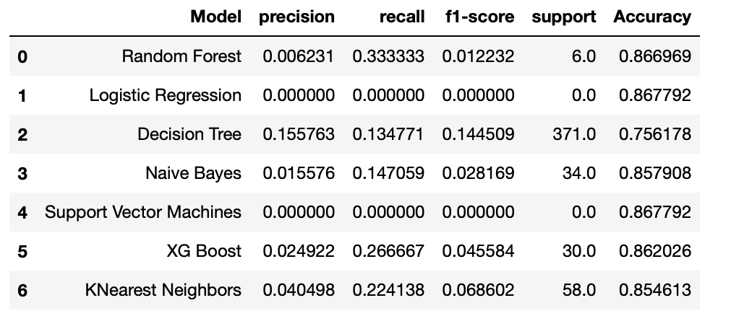
The Metrics are techniques through which we compare and contrast between our models
Metrics We are using:
Accuracy of the model prediction.
Precision.
Recall.
Misclassification Rate.
F1 Score.

Slide 12
THANK YOU

